Slide 1
Curriculum and Course Design for Mechatronics and Robotics Engineering Education ASEE Workshop Sunday, June 26, 2022 Minneapolis, Minnesota
Carlotta A. Berry, PhD
Professor
Lawrence J. Giacoletto Endowed Chair In
Electrical and Computer Engineering
ROSE-HULMAN INSTITUTE OF TECHNOLOGY
Notes:
Schedule
Introduction (10 minutes) – Introduce the workshop origins, goals, and mission.
Session I (45 minutes) Mechatronics & Robotics Engineering Curricula
Motivation, goals, objectives, and outcomes
Core courses, electives, capstone projects
Break (10 minutes)
Session II (45 minutes) Introduction to Mechatronics & Robotics Courses
Course organization and objectives
Homework / Labs / Projects
Break (10 minutes)
Session III (45 minutes) Intermediate & Advanced Mechatronics & Robotics Courses
Course organization and objectives
Homework / Labs / Projects
Capstone design projects
Summary and Future Directions (15 minutes)
Room: MCC - 205A

Slide 2
Software Design Plans and Simulators
SDP enable students to develop a systematic approach for robot algorithms
SDP give them options for creating their code including pseudocode, state diagrams, flow charts, and subsumption architecture
Simulators allow students to test out and debug their theories before dealing with odometry error, bandwidth limitations, memory issues, power consumption, and sensor error

Slide 3
Pseudocode
An algorithm is a procedure for solving a problem in terms of actions to be executed.
Pseudocode is an artificial and informal language that helps programmers develop algorithms.

Slide 4
Pseudocode Example (Stopwatch)
Initialize counter to 0
Initialize reset to 1
Initialize run to 0
Is the button pressed?
No, stay in current state, reset
Yes, increment counter, set reset to zero, set run to 1
3 states
Reset
Run
Stop
Is the button pressed?
No, stay in current state, run
Yes, save final counter value, reset still 0, set run to 0
Is the button pressed?
No, stay in current state, stop
Yes, return to reset
Notes:
Can also be more like a programming language, if statements, etc… do example

Slide 5
Flowchart Example (Stopwatch)
Start
Clear
State0
Counter=0
Reset=1
Run=0
Button
0
Run
1
1
Counter=Counter+1
Reset=0
Run=1
Button
3 states
Reset
Run
Stop
0
State1
Button
0
1
Counter=Counter
Reset=0
Run=0
Stop

Slide 6
State Diagram Example (Stopwatch)
Notes:
If I was writing code, I would make functions reset, run and stop

Slide 7
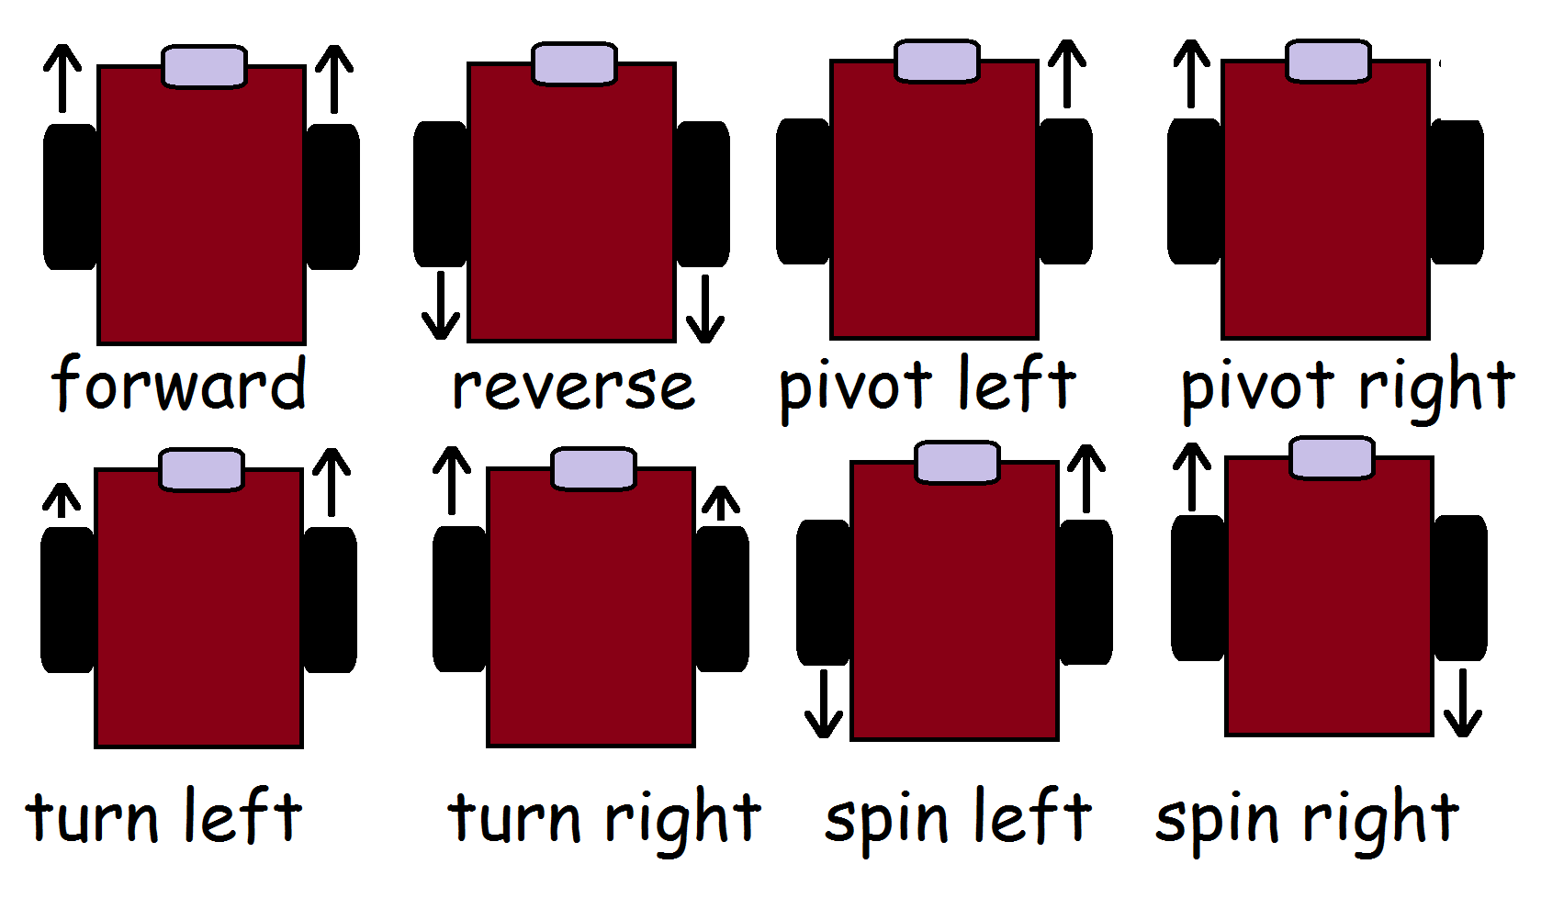
Robot Motions

Slide 8
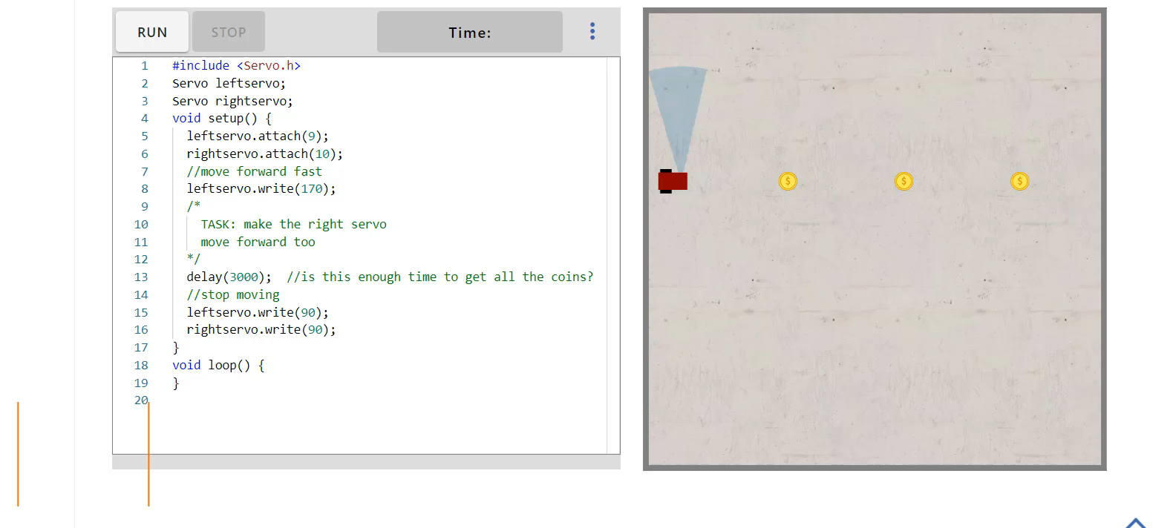
Simulate Robot Motions

Slide 9
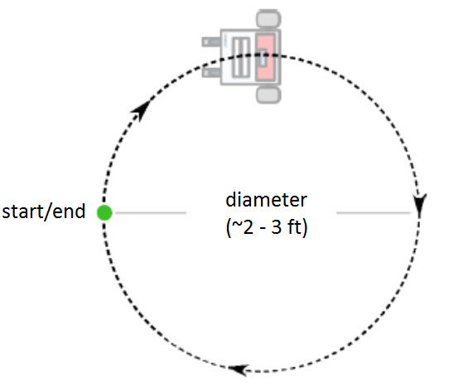
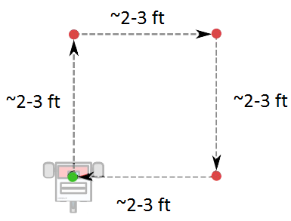
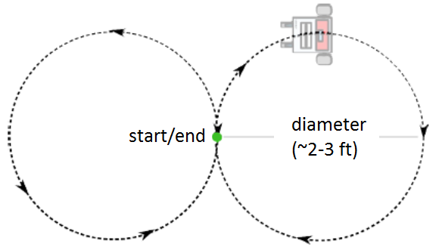
Robot Motions
Notes:
<object width="560" height="315"><param name="movie" value="//www.youtube.com/v/huQSWZX1Glo?hl=en_US&amp;version=3&amp;rel=0"></param><param name="allowFullScreen" value="true"></param><param name="allowscriptaccess" value="always"></param><embed src="//www.youtube.com/v/huQSWZX1Glo?hl=en_US&amp;version=3&amp;rel=0" type="application/x-shockwave-flash" width="560" height="315" allowscriptaccess="always" allowfullscreen="true"></embed></object>

Slide 10
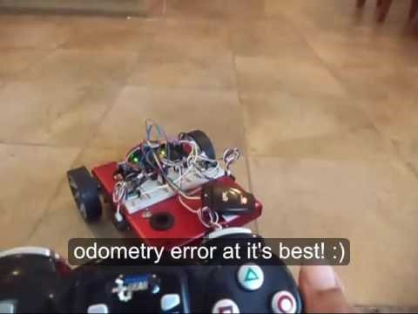
Robot Motions

Slide 11
Simulator for Robot Motion
Go to Dawson virtual robot simulator
modify code to move forward to collect all coins
write code to move robot in a s
square
Circle
figure 8
Simulator link:
bit.ly/dawsonSim1

Slide 12
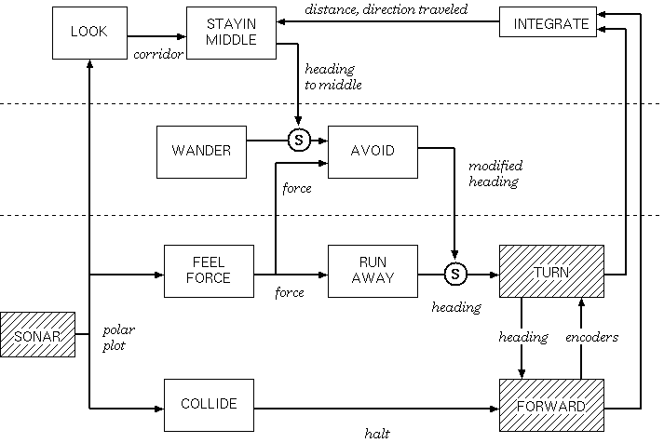
Wall Following Subsumption Architecture
Add
Follow Left & Follow Right

Slide 13
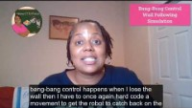
Wall Following Simulation

Slide 14
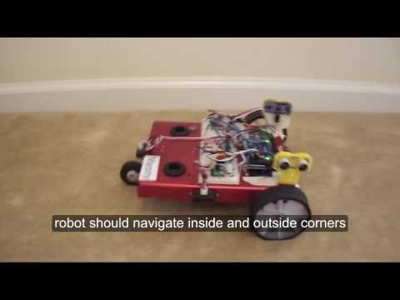
Wall Following with Bang-Bang Control

Slide 15
Robot Simulator for Wall Following
Go to Dawson virtual robot simulator
modify code to drive robot to follow wall
modify code to drive robot to follow wall and collect all coins
modify code to follow wall and collect coins robot using bang-bang control
modify code to follow wall and collect coins robot using proportional control
modify code to follow wall and collect coins robot using PD control
Simulator link:
bit.ly/dawsonSim2

